Slide 1
LHC-300 LED Assembly Cable
Wiring Instructions
OpenAg, MIT Media Lab
By Eugene Zeleny
October 8th, 2019

Slide 2
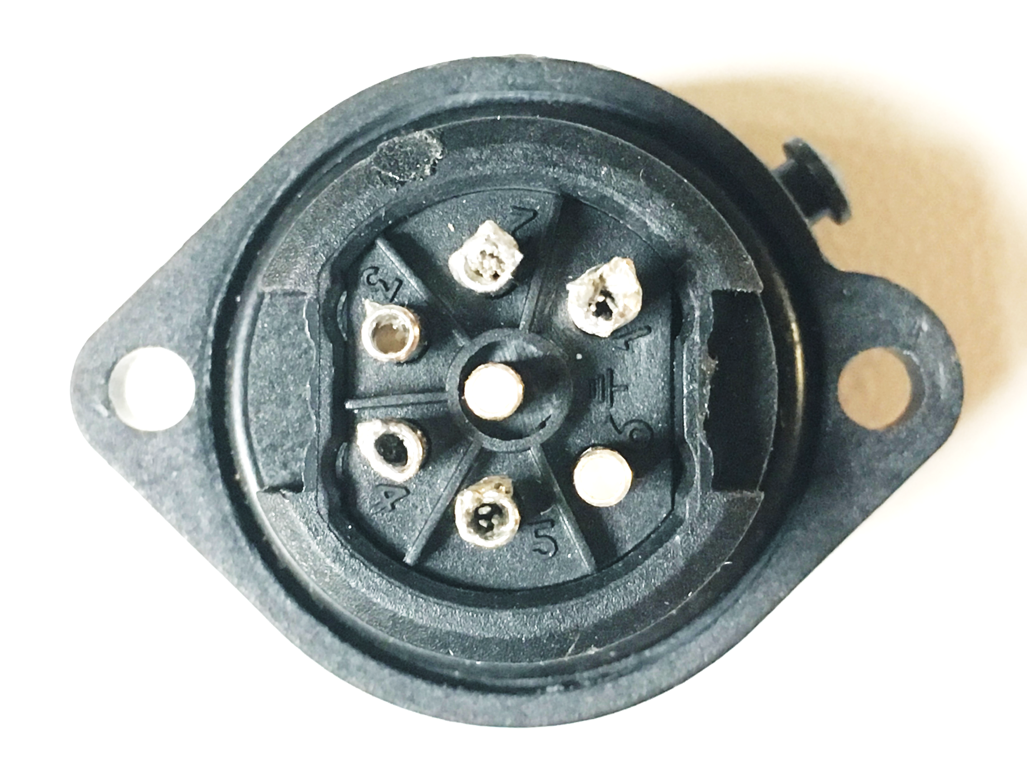
Male End Wiring (embedded in LED Enclosure)
Poles 4/5
ORANGE
Poles 3/6
RED
Poles 1/2
YELLOW
FOR REFERENCE ONLY (these have been made):
Poles 4/5 go to light WARM/ORANGE light
Poles 1/2 go to COOL/YELLOW light
Poles 3/6 go to RED light

Slide 3
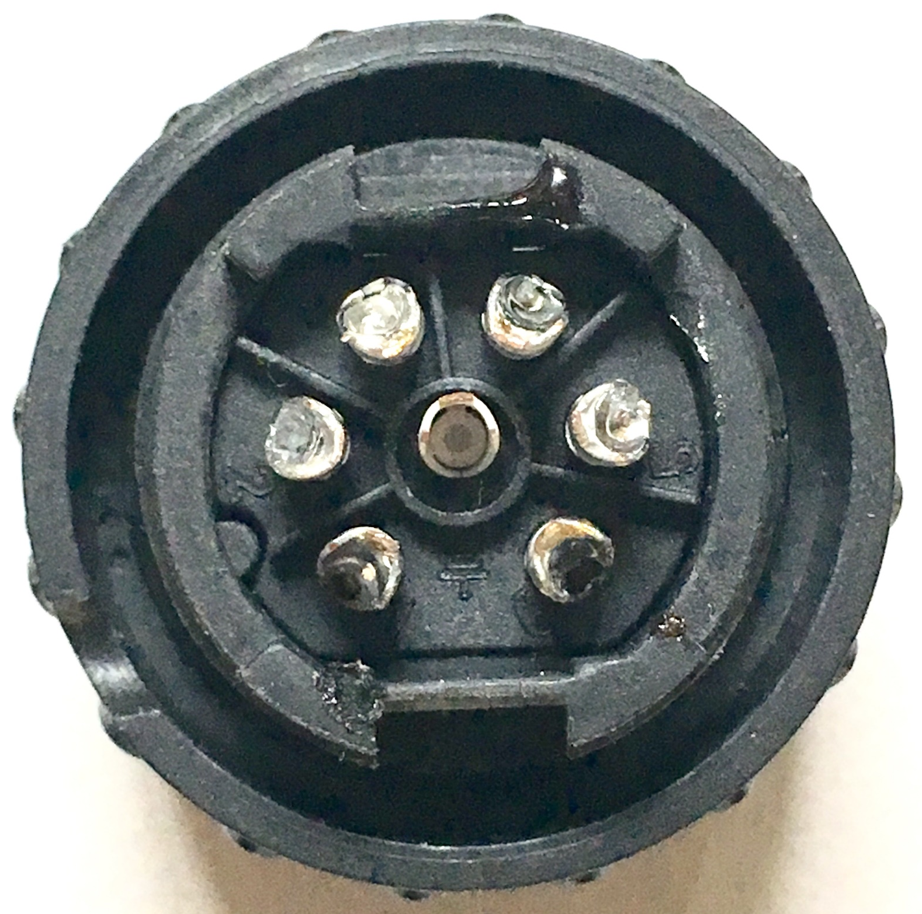
Female End Wiring (cable connector)
4
3
2
5
6
1
Important Note: Pole Numbers align between both connectors
1-to-1, 6-to-6, etc

Slide 4
Poles 4/5
ORANGE
Poles 3/6
RED
Poles 1/2
YELLOW
Poles 4/5
ORANGE
3
4
5
2
6
1
Poles 1/2
YELLOW
Poles 3/6
RED
On Female (cable) connector:
Green/Blue = Black
Brown/White = Red

Slide 5
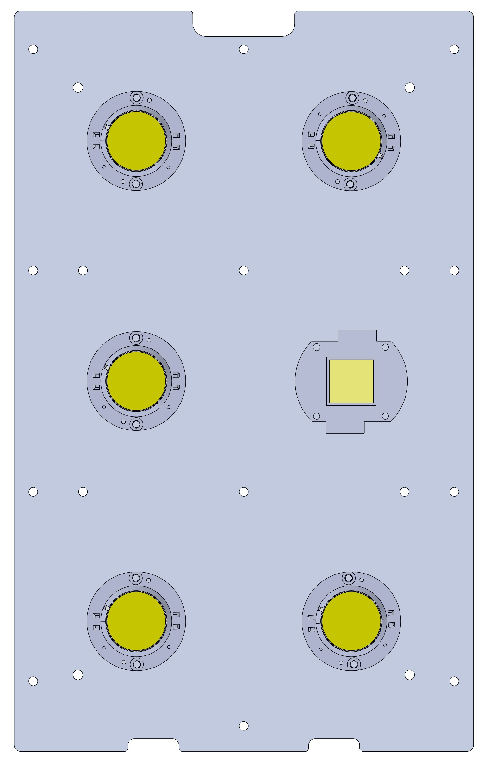
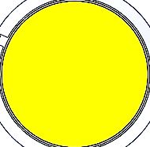
WIRES OUT
YELLOW
ORANGE
YELLOW
ORANGE
Poles 1/2
YELLOW
Poles 4/5
ORANGE
FOR REFERENCE ONLY:
For the 40 Yellow/Orange Light Units, use the indicated wiring diagram
Poles 4/5 go to light WARM/ORANGE light
Poles 1/2 go to COOL/YELLOW light

Slide 6
WIRES OUT
YELLOW
ORANGE
Poles 3/6
YELLOW
Poles 1/2
YELLOW
Poles 4/5
ORANGE
FOR REFERENCE ONLY:
For the 8 Yellow/Orange/Red Light Units, use the indicated wiring diagram
Poles 4/5 go to light WARM/ORANGE light
Poles 1/2 go to COOL/YELLOW light
Poles 3/6 go to RED light

